Slide 1



GROUP 3
SEARCHING

Slide 2
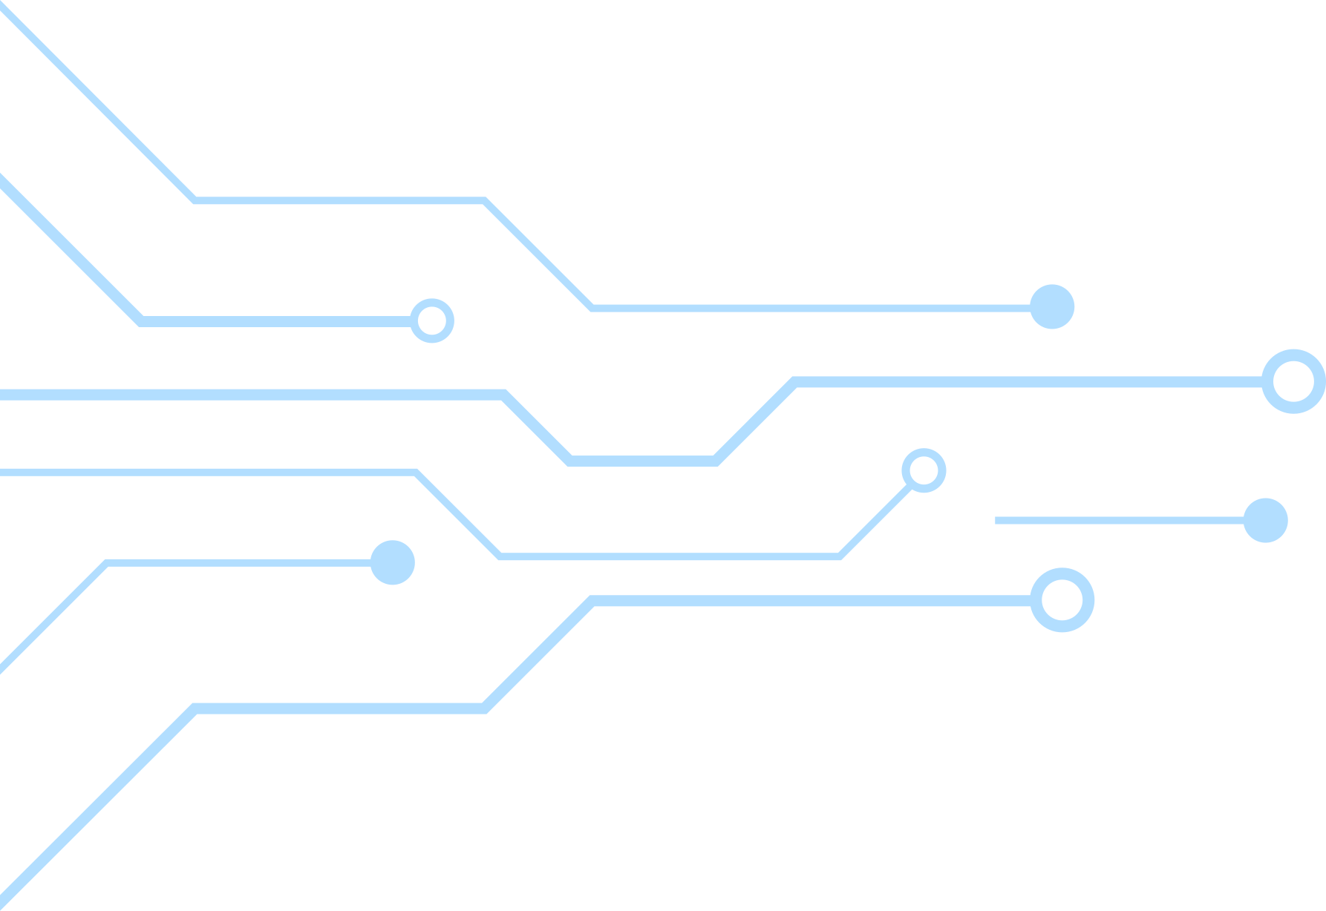



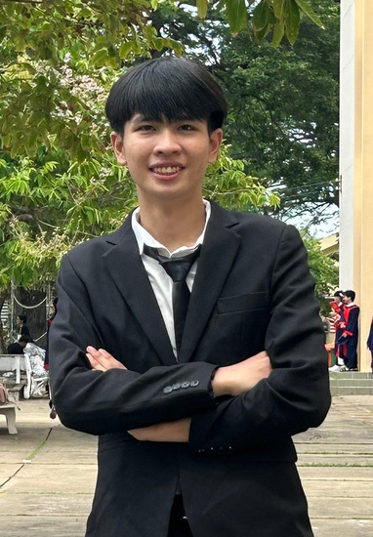

Our Team
Đặng Đăng Khoa
Đặng Trường Nguyên
Nguyễn Trần Quốc Duy
Nguyễn Trọng Tài
23127207
23127438
23127181
23127006

Slide 3

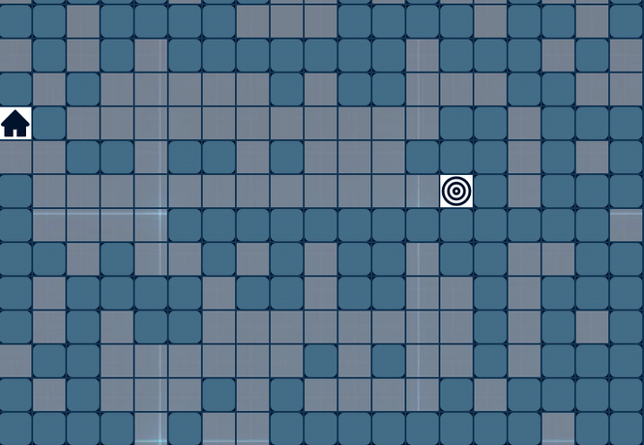
Problem Statement
Path Finding in Maze
Find the shortest or optimal path from a designated start point to a goal point in a 2D maze that contains obstacles (walls) using various search algorithms.

Slide 4
Problem Modeling
State: A state is defined as the current position of the agent in the maze, represented by coordinates (x, y)
Initial State: Starting position S = (x₀, y₀)
Goal State: Target position G = (xₘ, yₘ)
State Space = {(x, y) | 0 ≤ x < width, 0 ≤ y < height, maze[x][y] ≠ wall}
Actions: UP, DOWN, LEFT, RIGHT (if within bounds & not wall)
Properties: Finite, Discrete, Fully Observable, Deterministic
Transition: Result(s, a) = s' if valid; undefined otherwise

Slide 5


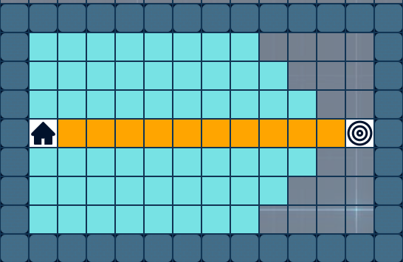
Grid Representation
Wall/Obstacle (Blocked)
Explored nodes (During search)
For a 25×25 maze with w walls
Total cells: 25 × 25
Valid states: (25 × 25) - w
Branching factor: Maximum 4 (up, down, left, right)
Goal position (Target state)
Start position (Initial state)
Solution path (Final result)
Free space (Walkable)

Slide 6
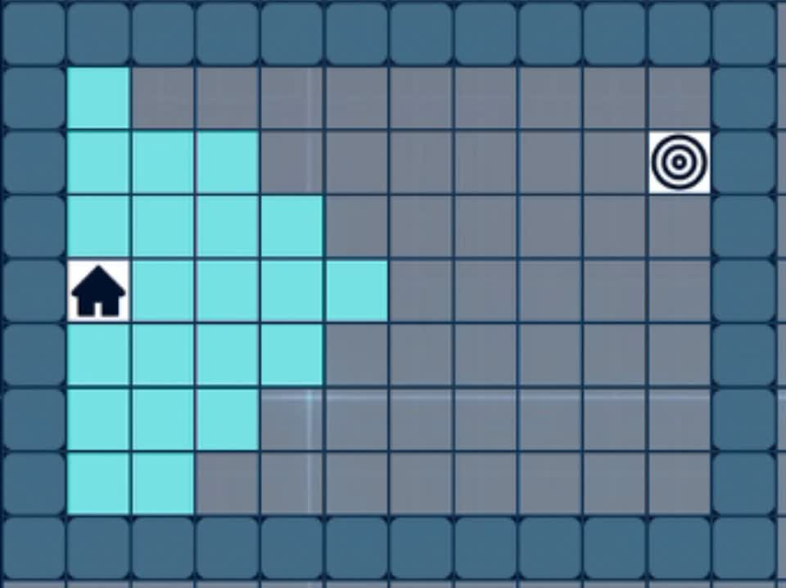
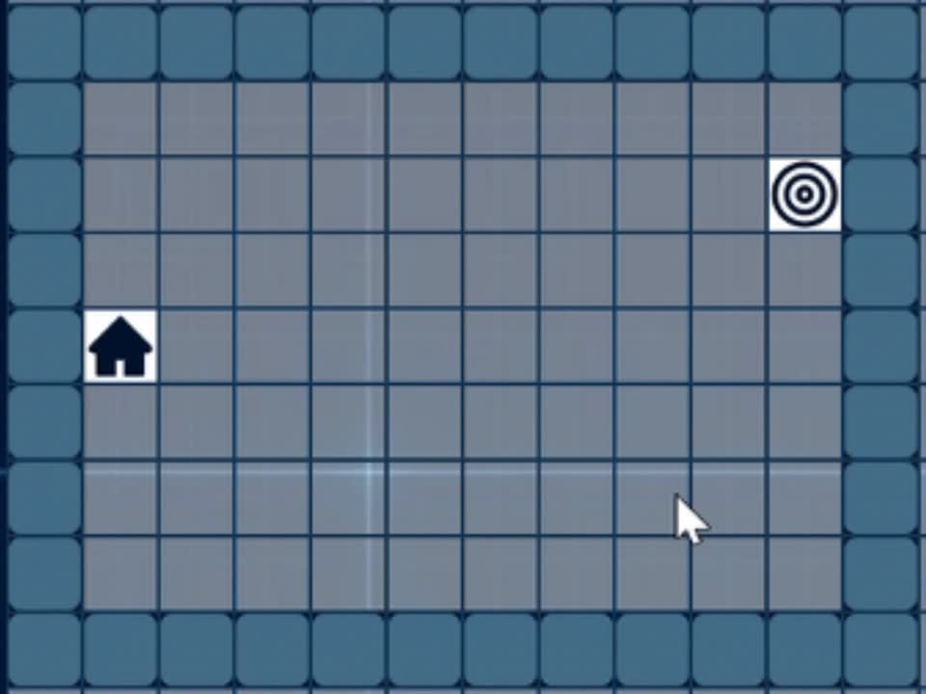
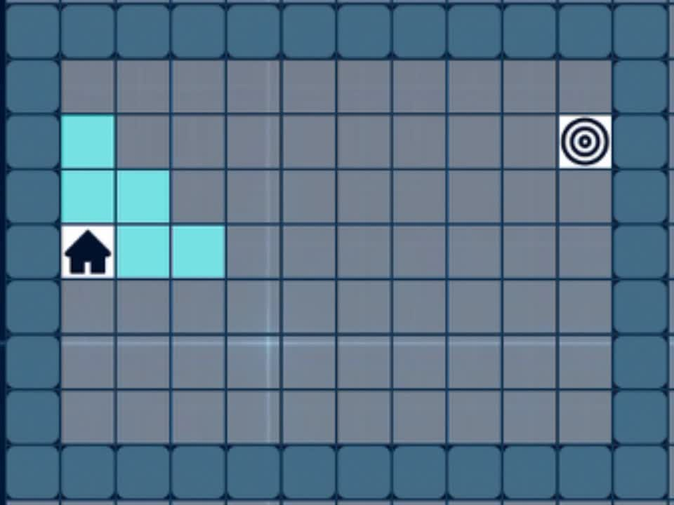
Algorithm Principles
Breadth-First Search (BFS)
Depth-First Search (DFS)
A* (A-star) Search
Explores nodes level by level, starting from the root.
Explores deep along branches before backtracking.
Combines Uniform Cost Search and Greedy Best-First Search.
Uses a queue (FIFO) to manage exploration order.
Uses a stack (LIFO) or recursion to track nodes.
Selects node with lowest total estimated cost:
f(n) = g(n) + h(n)
Guarantees shortest path if all edge costs are equal.
Does not guarantee shortest path; may get stuck without depth limits or visited checks.
If h(n) is admissible, A* is optimal and complete.

Slide 7
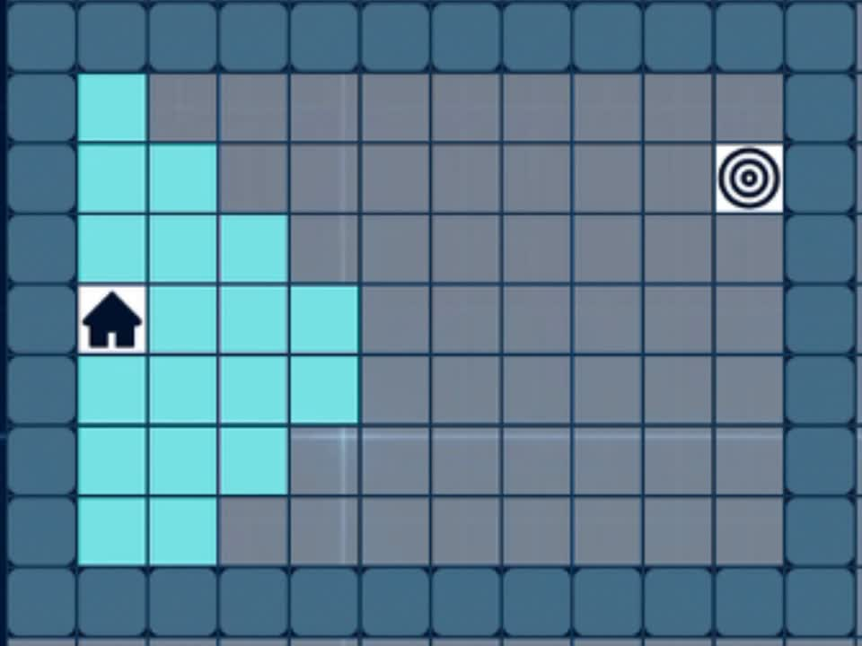
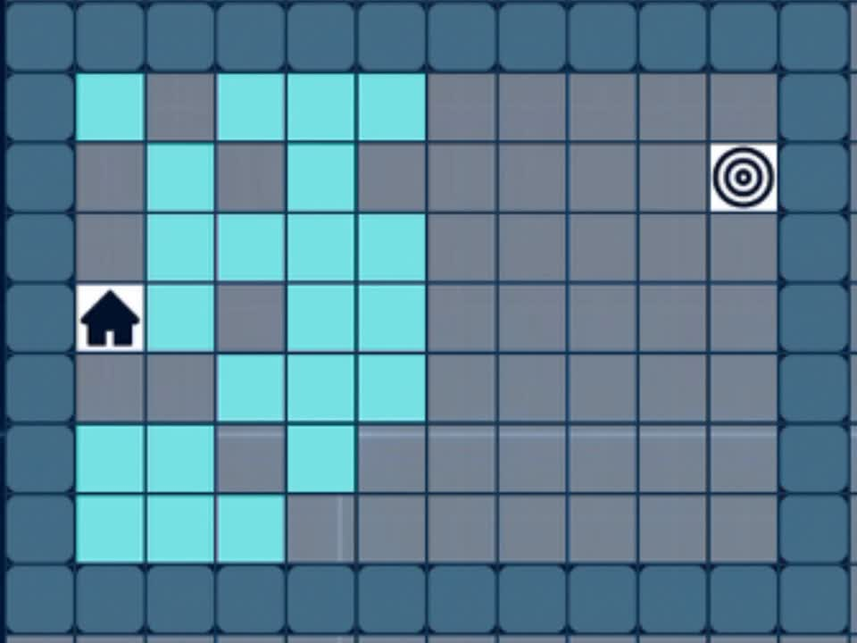
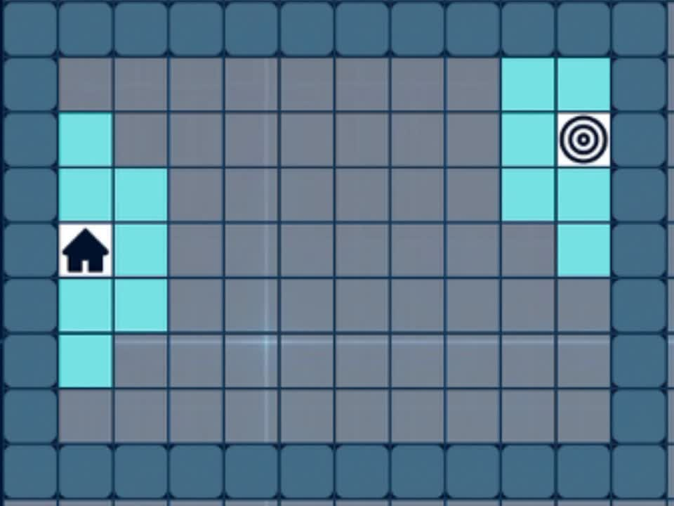
Algorithm Principles
Uniform Cost Search (UCS)
Iterative Deepening Depth-First Search (IDDFS)
Bi-directional Search
Expands the node with the lowest cumulative cost from the start.
Runs depth-limited DFS repeatedly with increasing depth:
Runs two simultaneous searches:
Combines DFS’s space efficiency with BFS’s completeness and optimality (when costs are uniform)
One forward from the start
Uses a priority queue based on path cost g(n).
One backward from the goal
Optimal and complete if all edge costs are non-negative.
Stops when both frontiers meet, requires the path to be reversible.
Greatly reduces search space: O(bᵈ) to ≈ O(bᵈ⁄²)

Slide 8
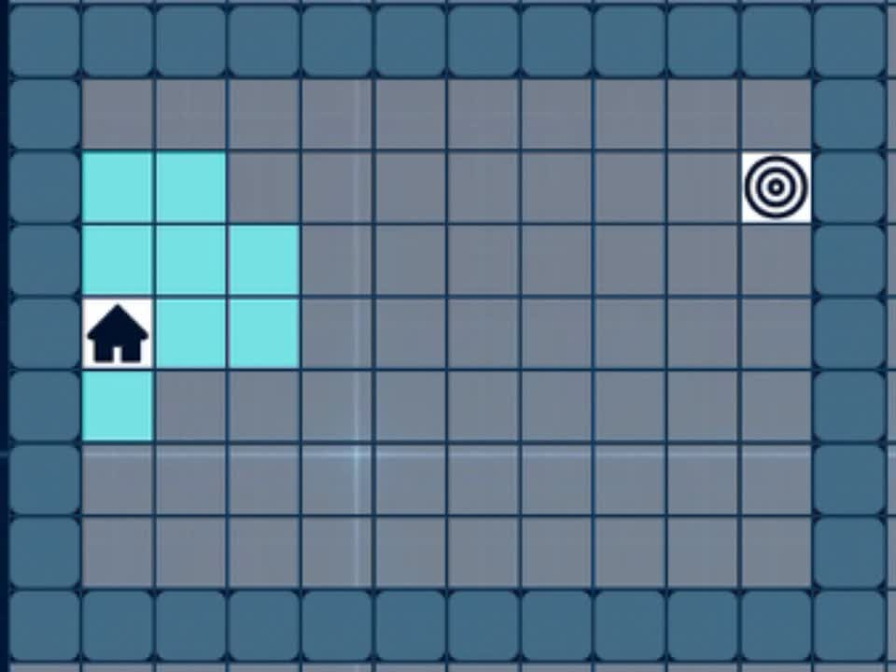
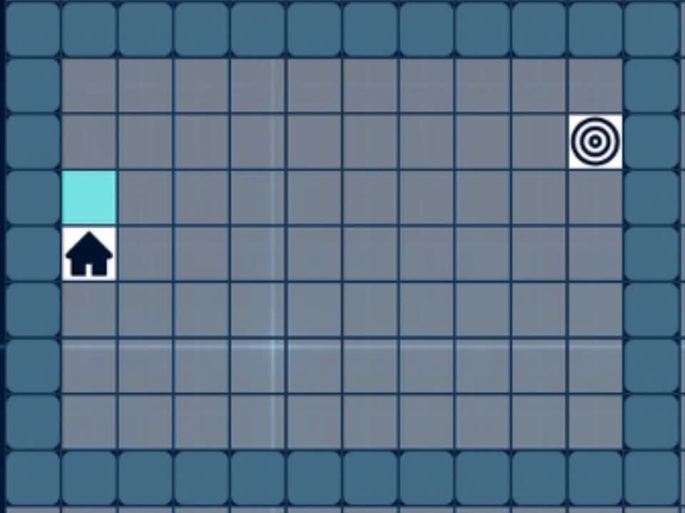
Algorithm Principles
Beam Search
Iterative Deepening A* (IDA*)
Heuristic search that expands only the top-k most promising nodes at each level (beam width = k).
Combines A* and Depth-Limited DFS
Uses f(n) = g(n) + h(n) as cost threshold
Unlike BFS, it prunes less promising paths to reduce memory and computation.
Starts with threshold = h(start)
Performs DFS limited to f(n) ≤ threshold
Not complete (can miss the goal).
If goal not found, threshold increases to the smallest f(n) that exceeded it
Not optimal (can miss the best path).
Widely used in NLP tasks like speech recognition and machine translation.
Optimal and complete with admissible heuristics, lower memory usage than A* (DFS-based), Suitable for large search spaces

Slide 9
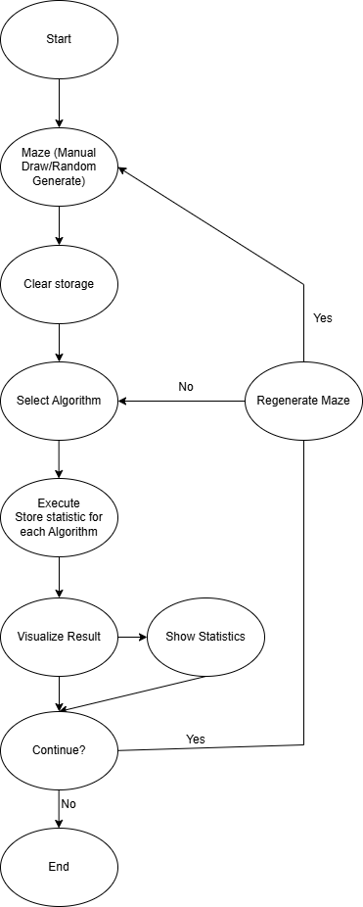
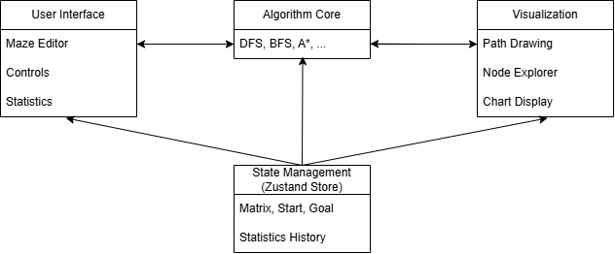
Overall System Architecture Diagram
Program Flow
Main Application Flow

Slide 10
Program Flow
AI-Searching/
├── Web/
│ └── client/
│ └── src/
│ └── app/
│ └── (pages)/
│ └── (home)/page.js # Menu page
│ └── analyse/
│ └── cost/page.jsx # Cost comparison page
│ └── nodes-explored/page.jsx # Nodes-explored comparison page
│ └── path-length/page.jsx # Path length comparison page
│ └── processing-time/page.jsx # Processing time comparison page
│ └── game/page.jsx # Main maze game page
│ └── team/page.jsx # Team’s member information page
│ └── store/statStore.js # Zustand storage
│ └── helpers/algorithm.helper.js # Searching algorithm
├── README.md

Slide 11
Algorithm Comparison
Algorithm | Time Complexity | Space Complexity | Optimality
Uniform Cost Search (UCS) | O(bC/ε ) where C is cost of optimal solution, ε is minimum step cost | O(bC/ε ) | Yes (if costs are non-negative)
A* | Exponential in worst case; faster with good heuristics | Exponential (stores open set) | Yes (if heuristic is admissible and consistent)
Iterative Deepening DFS (IDDFS) | O(bd ) – where d is depth of goal node | O(b·d) | Yes (if goal is at known or bounded depth)
Bi-directional Search | O(bd/2 ) | O(bd/2 ) | Yes (if both searches are complete and meet)
Beam Search | O(B·d) – B is beam width, d is depth | O(B·d) | No (may discard optimal path during pruning)
Iterative Deepening A* (IDA*) | Exponential, similar to A* with less overhead | O(d) (depth of solution) | Yes (if heuristic is admissible)
BFS | O(V + E) | O(V) | Yes(due to its strategy of exploring nodes in order of increasing depth)
DFS | O(V + E) | O(H), H = max depth | No(may go deep along incorrect paths before finding the goal)

Slide 12


Program Instructions

Slide 13





Algorithms like DFS, IDDFS, Beam Search, and IDA* may run indefinitely on complex mazes due to the absence of timeout or function-based protection.
Infinite Loop Risk
Lack of Touch/Mobile Support
The application relies on mouse interactions, hindering usability on touch devices.
LIMITATION
No Save/Share Functionality
Users cannot save maze configurations or share them via links.
Insufficient Algorithm Validation
Missing unit tests in algorithm.helper.js prevent thorough verification of search algorithm correctness.

Slide 14

Future Work
Advanced Algorithm Integration
Undo / Redo & State Management
Add onTouchStart and onTouchMove support for smooth mobile interactions.
Add timeout, cancellation token, or custom flag to prevent freezing in unsolvable mazes.
Weighted & Customizable Mazes

Slide 15
THANK YOU

